Slide 1
The Memory Hierarchy

Slide 2
Locality to the Rescue
Locality of memory references
  Property of real programs, few exceptions
  Books and library analogy (next slide)
Temporal locality
  Recently referenced data is likely to be referenced again soon
  Reactive: cache recently used data in small, fast memory
Spatial locality
  More likely to reference data near recently referenced data
  Proactive: fetch data in large chunks to include nearby data
Holds for data and instructions

Slide 3
Library Analogy
Consider books in a library
Library has lots of books, but it is slow to access
  Far away (time to walk to the library)
  Big (time to walk within the library)
How can you avoid these latencies?
  Check out books, take them home with you
    Put them on desk, on bookshelf, etc.
  But desks & bookshelves have limited capacity
    Keep recently used books around (temporal locality)
    Grab books on related topic at the same time (spatial locality)
    Guess what books you’ll need in the future (prefetching)

Slide 4
Library Analogy Explained
Registers ↔ books on your desk
  Actively being used, small capacity
Caches ↔ bookshelves
  Moderate capacity, pretty fast to access
Main memory ↔ library
  Big, holds almost all data, but slow
Disk (virtual memory) ↔ inter-library loan
  Very slow, but hopefully really uncommon

Slide 5
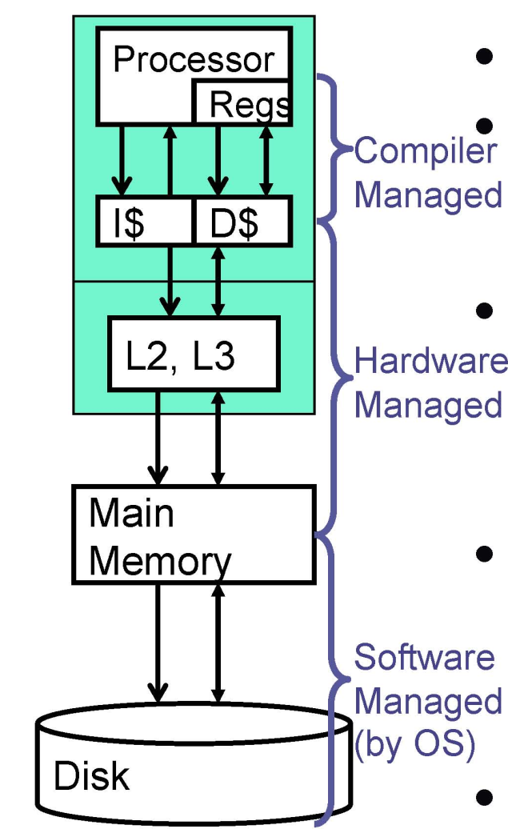
Concrete Memory Hierarchy
0th level: Registers
1st level: Primary caches
  Split instruction (I$) and data (D$)
  Typically 8KB to 64KB each
2nd level: 2nd and 3rd cache (L2, L3)
  On-chip, typically made of SRAM
  2nd level typically ~256KB to 512KB
  “Last level cache” typically 4MB to 16MB
3rd level: main memory
  Made of DRAM (“Dynamic” RAM)
  Typically 1GB to 4GB for desktops/laptops
    Servers can have 100s of GB
4th level: disk (swap and files)
  Uses magnetic disks or flash drives

Slide 6
Why Cache?
Analysis several programmed show that computer memory tend to refer into one particular area.
This phenomenon is named as locality of reference.
This phenomenon give strong argument so that data those involve in this phenomenon is housed into memory high speed(cache memory), which it can speed up whole system access time (overall access time).

Slide 7
Cache Memory
Cache: safe place to hide or to save data
Location between CPU and main memory
To reduce access time to main memory
Also use in I/O device
Cache using SRAM : Static Random Access Memory
  No refresh

Slide 8
Computer With Cache
Processor
Main
Memory
Address Bus
Cache
Memory
Data Bus

Slide 9

Typical Cache Organization

Slide 10

Cache
Small amount of fast memory
Sits between normal main memory and CPU
May be located on CPU chip or module

Slide 11
Cache Operation - Review
CPU requests contents of memory location
Check cache for this data
If present, get from cache (fast)
If not present, read required block from main memory to cache
Then deliver from cache to CPU
Cache includes tags to identify which block of main memory is in each cache slot
.

Slide 12
Cache Addressing
START
Is Block in
Cache?
No
Access main memory
for block containing RA
Yes
Fetch RA word and
deliver to CPU
Alloc. cache slot for
main memory block
Deliver RA word
to CPU
Load main memory
block into cache slot
DONE

Slide 13
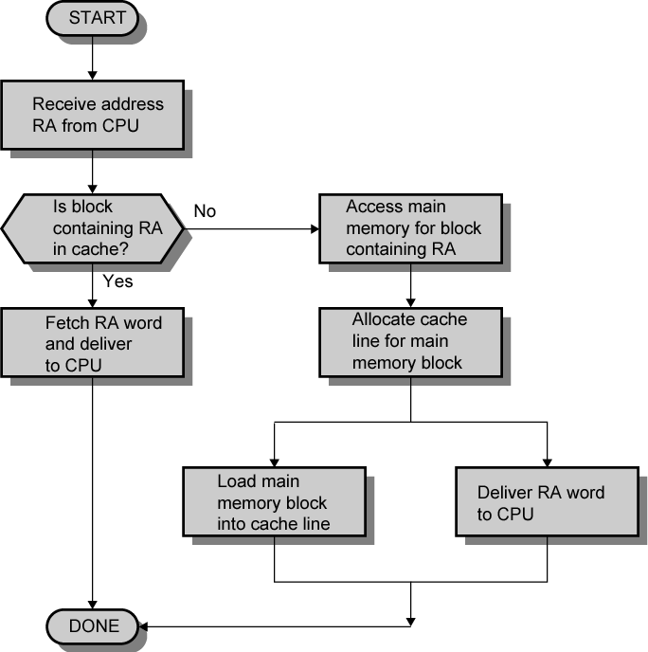
Cache Read Operation

Slide 14
Terminologi Cache
Hit
  an access where the data is found in the cache
Miss
  an access which is not found in the cache

Slide 15
Cache Performance
Hit time: time to access the cache
Miss penalty: Time to process a cache miss
– Move data from lower level memory to the cache and CPU
Hit ratio: % of time the data is found in the cache
Miss ratio: (1 - hit ratio)
Cache block size or cache line size: the amount of data that gets transferred on a cache miss
Effective access time:– (Hit Ratio * Hit Time) + (Miss Ratio * Miss Time)

Slide 16
Can Cache Increases Performance Of The System?
Take the following access time of A computer system, (T_{ma} = 500ns)
Based on the above, the overall access time to the memory with no cache is,
    T_{acc} = T_{ma} = 500ns
If the above system has a cache with an access time of 50ns (T_{ca}) and a hit ratio of 90%, the overall access time is,
T_{acc} = (T_{ca} X 0.90) + (T_{ma} X (1-0.9))
T_{acc} = (50 X 0.90) + (500 x 0.10)
T_{acc} = (45) + (50)
T_{acc} = 95ns

Slide 17
Design Consideration
Implementing a cache requires due consideration and tradeoffs between the following:-
  The Hit Ratio
  Access Time on a Hit
  Delay Time on a Miss
  Cost

Slide 18
Cache Design
Size
Mapping Function
Replacement Algorithm
Write Policy
Block Size
Number of Caches

Slide 19
Size does matter
Cost
  More cache is expensive
Speed
  More cache is faster (up to a point)
  Checking cache for data takes time

Slide 20
Mapping Function
Cache of 64kByte
Cache block of 4 bytes
  i.e. cache is 16k (2¹⁴) lines of 4 bytes
16MBytes main memory
24 bit address
  (2²⁴=16M)

Slide 21
Direct Mapping
Each block of main memory maps to only one cache line
  i.e. if a block is in cache, it must be in one specific place
Address is in two parts
Least Significant w bits identify unique word
Most Significant s bits specify one memory block
The MSBs are split into a cache line field r and a tag of s-r (most significant)

Slide 22
Direct Mapping
Address Structure
Tag s-r
Line or Slot r
Word w
8
14
2
24 bit address
2 bit word identifier (4 byte block)
22 bit block identifier
  8 bit tag (=22-14)
  14 bit slot or line
No two blocks in the same line have the same Tag field
Check contents of cache by finding line and checking Tag

Slide 23
Direct Mapping
Cache Line Table
Cache line Main Memory blocks held
0 0, m, 2m, 3m…2s-m
1 1,m+1, 2m+1…2s-m+1
m-1 m-1, 2m-1,3m-1…2s-1

Slide 24
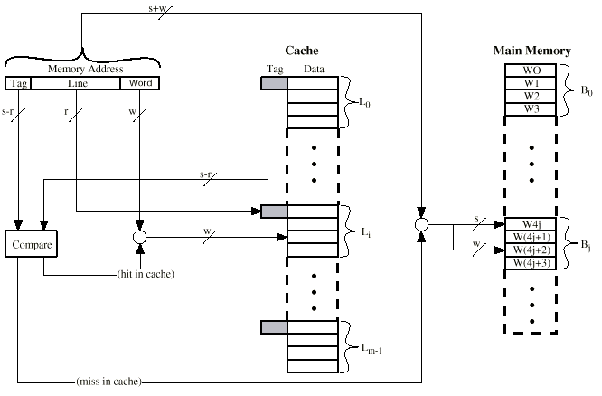
Direct Mapping Cache Organization

Slide 25
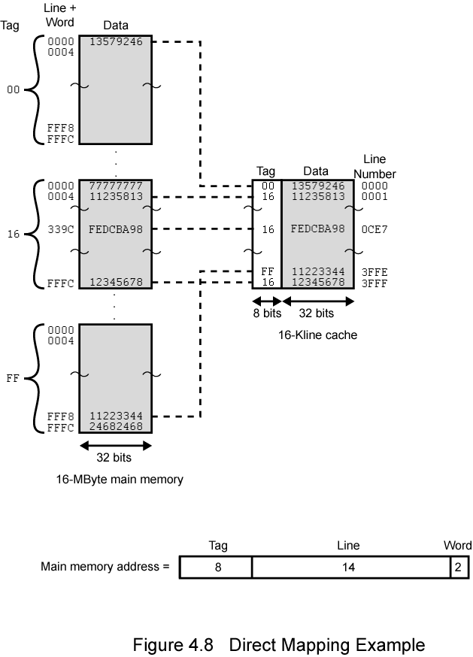
Direct Mapping Example

Slide 26

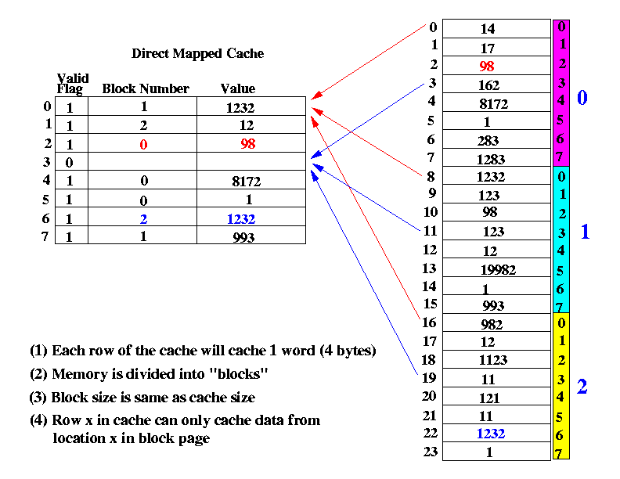
Direct Mapping Example

Slide 27
Direct Mapping Summary
Address length = (s + w) bits
Number of addressable units = 2s+w words or bytes
Block size = line size = 2w words or bytes
Number of blocks in main memory = 2s+ w/2w = 2s
Number of lines in cache = m = 2r
Size of tag = (s – r) bits

Slide 28
Direct Mapping pros & cons
Simple
Inexpensive
Fixed location for given block
  If a program accesses 2 blocks that map to the same line repeatedly, cache misses are very high

Slide 29
Associative Mapping
A main memory block can load into any line of cache
Memory address is interpreted as tag and word
Tag uniquely identifies block of memory
Every line’s tag is examined for a match
Cache searching gets expensive

Slide 30

Fully Associative Cache Organization

Slide 31
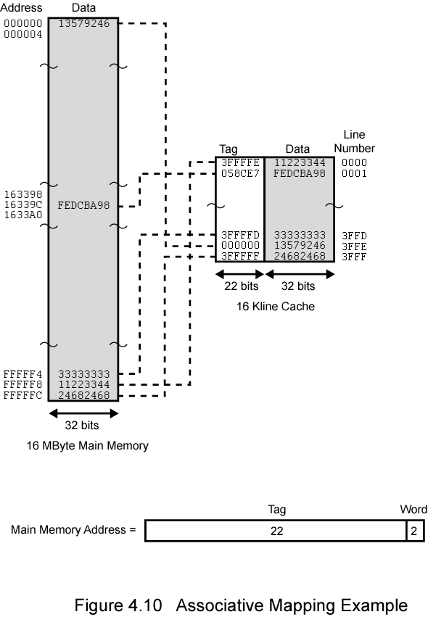
Associative Mapping Example

Slide 32
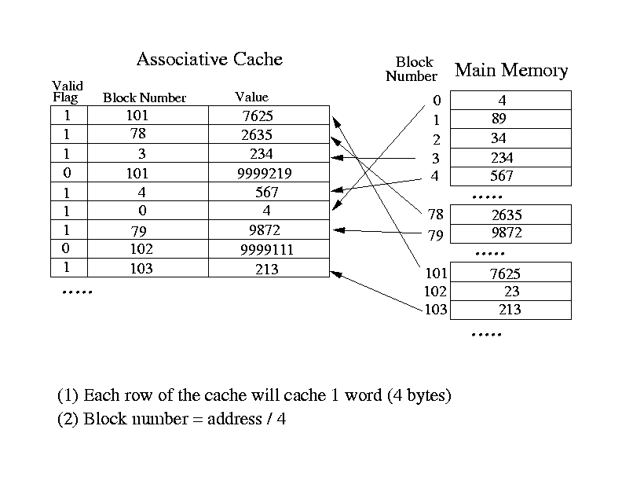
Associative Mapping Example

Slide 33
Associative Mapping
Address Structure
Word
2 bit
Tag 22 bit
22 bit tag stored with each 32 bit block of data
Compare tag field with tag entry in cache to check for hit
Least significant 2 bits of address identify which 16 bit word is required from 32 bit data block
e.g.
  Address Tag Data Cache line
  FFFFFC FFFFFC 24682468 3FFF

Slide 34
Associative Mapping Summary
Address length = (s + w) bits
Number of addressable units = 2s+w words or bytes
Block size = line size = 2w words or bytes
Number of blocks in main memory = 2s+ w/2w = 2s
Number of lines in cache = undetermined
Size of tag = s bits

Slide 35
Set Associative Mapping
Cache is divided into a number of sets
Each set contains a number of lines
A given block maps to any line in a given set
  e.g. Block B can be in any line of set i
e.g. 2 lines per set
  2 way associative mapping
  A given block can be in one of 2 lines in only one set

Slide 36
Set Associative Mapping
Example
13 bit set number
Block number in main memory is modulo 2¹³
000000, 00A000, 00B000, 00C000 … map to same set

Slide 37
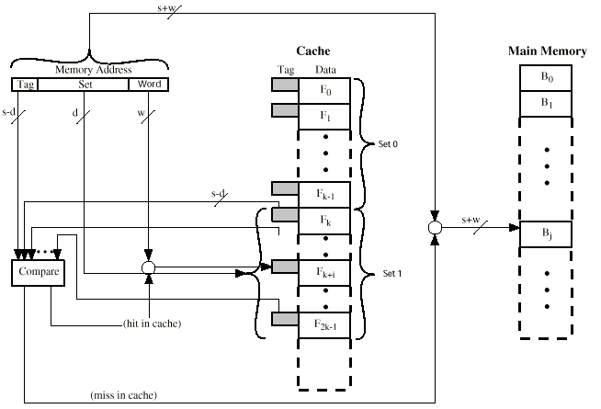
Two Way Set Associative Cache Organization

Slide 38
Set Associative Mapping
Address Structure
Word
2 bit
Tag 9 bit
Set 13 bit
Use set field to determine cache set to look in
Compare tag field to see if we have a hit
e.g
  Address Tag Data Set number
  1FF 7FFC 1FF 12345678 1FFF
  001 7FFC 001 11223344 1FFF

Slide 39
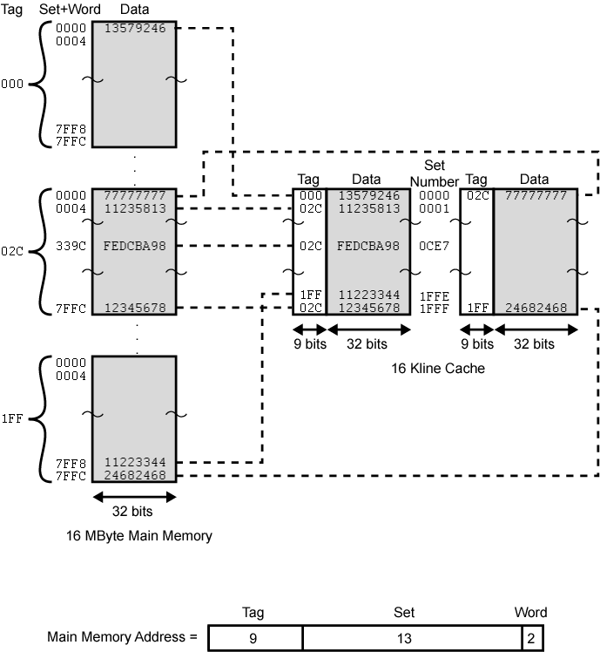
Two Way Set Associative Mapping Example

Slide 40
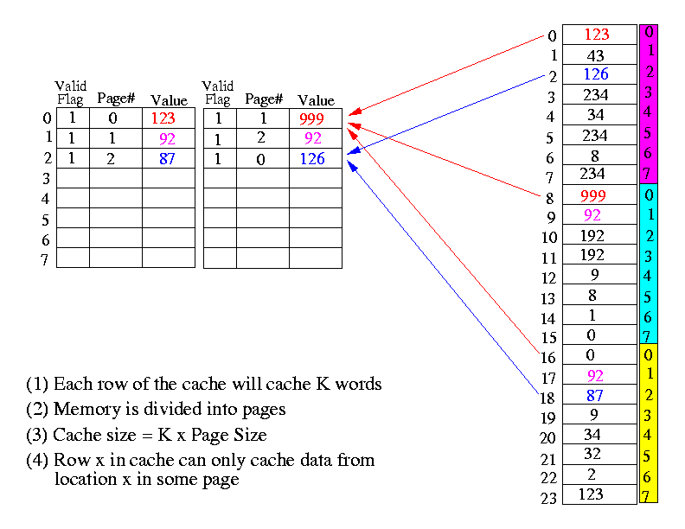
Set Associative Mapping Example

Slide 41
Set Associative Mapping Summary
Address length = (s + w) bits
Number of addressable units = 2s+w words or bytes
Block size = line size = 2w words or bytes
Number of blocks in main memory = 2d
Number of lines in set = k
Number of sets = v = 2d
Number of lines in cache = kv = k * 2d
Size of tag = (s – d) bits

Slide 42
Replacement Policy
When the cache full, what happen?
Which block from a set should be evicted?
It called replacement policy

Slide 43
Replacement Algorithms (1)
Direct mapping
No choice
Each block only maps to one line
Replace that line

Slide 44
Replacement Algorithms (2)
Associative & Set Associative
Hardware implemented algorithm (speed)
Least Recently used (LRU)
e.g. in 2 way set associative
  Which of the 2 block is lru?
First in first out (FIFO)
  replace block that has been in cache longest
Least frequently used
  replace block which has had fewest hits
Random

Slide 45
Write Policy
Must not overwrite a cache block unless main memory is up to date
Multiple CPUs may have individual caches
I/O may address main memory directly

Slide 46
Write through
All writes go to main memory as well as cache
Multiple CPUs can monitor main memory traffic to keep local (to CPU) cache up to date
Lots of traffic
Slows down writes
Remember bogus write through caches!

Slide 47
Write Through Cache
MAIN
MEMORY
12
CACHE
12
CPU
12
Area Of Activity

Slide 48
Write back
Updates initially made in cache only
Update bit for cache slot is set when update occurs
If block is to be replaced, write to main memory only if update bit is set
Other caches get out of sync
I/O must access main memory through cache
N.B. 15% of memory references are writes

Slide 49
Write Back Cache
MAIN
MEMORY
12
CACHE
12
CPU
Area Of Activity

Slide 50
Classifying Misses
Classifying Misses: 3 Cs
  Compulsory—The first access to a block is not in the cache, so the block must be brought into the cache. Also called cold start misses or first reference misses.
  (Misses in even an Infinite Cache)
  Capacity—If the cache cannot contain all the blocks needed during execution of a program, capacity misses will occur due to blocks being discarded and later retrieved.
  (Misses in Fully Associative Size X Cache)
  Conflict—If block-placement strategy is set associative or direct mapped, conflict misses (in addition to compulsory & capacity misses) will occur because a block can be discarded and later retrieved if too many blocks map to its set. Also called collision misses or interference misses.
  (Misses in N-way Associative, Size X Cache)

Slide 51
Pentium 4 Cache
80386 – no on chip cache
80486 – 8k using 16 byte lines and four way set associative organization
Pentium (all versions) – two on chip L1 caches
  Data & instructions
Pentium III – L3 cache added off chip
Pentium 4
  L1 caches
    8k bytes
    64 byte lines
    four way set associative
  L2 cache
    Feeding both L1 caches
    256k
    128 byte lines
    8 way set associative
  L3 cache on chip

Slide 52
Intel Cache Evolution
Problem
Solution
Processor on which feature first appears
External memory slower than the system bus.
Add external cache using faster memory technology.
386
Increased processor speed results in external bus becoming a bottleneck for cache access.
Move external cache on-chip, operating at the same speed as the processor.
486
Internal cache is rather small, due to limited space on chip
Add external L2 cache using faster technology than main memory
486
Contention occurs when both the Instruction Prefetcher and the Execution Unit simultaneously require access to the cache. In that case, the Prefetcher is stalled while the Execution Unit’s data access takes place.
Create separate data and instruction caches.
Pentium
Increased processor speed results in external bus becoming a bottleneck for L2 cache access.
Create separate back-side bus that runs at higher speed than the main (front-side) external bus. The BSB is dedicated to the L2 cache.
Pentium Pro
Move L2 cache on to the processor chip.
Pentium II
Some applications deal with massive databases and must have rapid access to large amounts of data. The on-chip caches are too small.
Add external L3 cache.
Pentium III
Move L3 cache on-chip.
Pentium 4

Slide 53
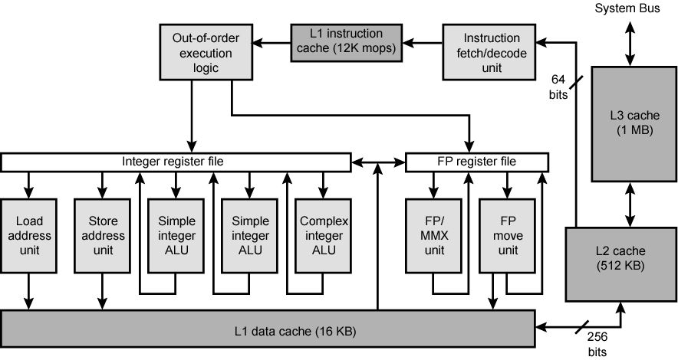
Pentium 4 Block Diagram

Slide 54
Pentium 4 Core Processor
Fetch/Decode Unit
  Fetches instructions from L2 cache
  Decode into micro-ops
  Store micro-ops in L1 cache
Out of order execution logic
  Schedules micro-ops
  Based on data dependence and resources
  May speculatively execute
Execution units
  Execute micro-ops
  Data from L1 cache
  Results in registers
Memory subsystem
  L2 cache and systems bus

Slide 55
Pentium 4 Design Reasoning
Decodes instructions into RISC like micro-ops before L1 cache
Micro-ops fixed length
  Superscalar pipelining and scheduling
Pentium instructions long & complex
Performance improved by separating decoding from scheduling & pipelining
  (More later – ch14)
Data cache is write back
  Can be configured to write through
L1 cache controlled by 2 bits in register
  CD = cache disable
  NW = not write through
  2 instructions to invalidate (flush) cache and write back then invalidate
L2 and L3 8-way set-associative
  Line size 128 bytes

Slide 56
PowerPC Cache Organization
601 – single 32kb 8 way set associative
603 – 16kb (2 x 8kb) two way set associative
604 – 32kb
620 – 64kb
G3 & G4
  64kb L1 cache
    8 way set associative
  256k, 512k or 1M L2 cache
    two way set associative
G5
  32kB instruction cache
  64kB data cache

Slide 57
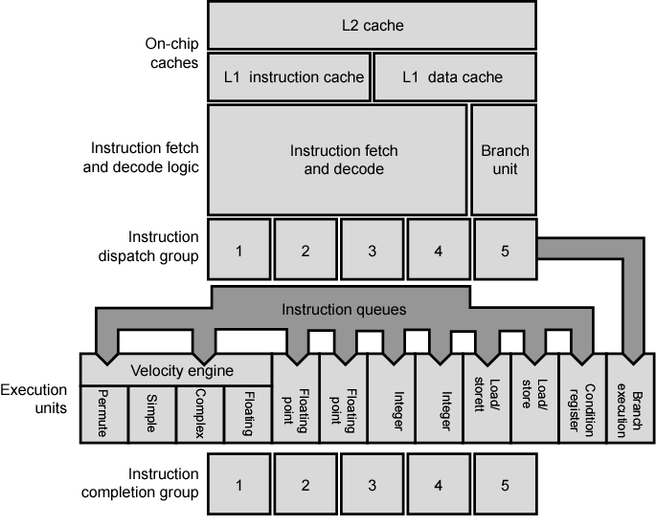
PowerPC G5 Block Diagram

Slide 58
Cache Mapping
Bcos of cache always smaller than main memory so we need a method to map to the cache. There are three common method:-
  Direct mapping
  Full associative mapping
  Set associative mapping
Mapping
Main Memory
Cache

Slide 59
Cache Mapping
Generally, to access computer memory is through address bus.
So, address bus width determine accessible memory number
Exp:-.
If address bus width is15 bit, the number of location that can be addressing is :-.
N = 15.
2^{n} = location.
2¹⁵= 32768.

Slide 60
Cache Mapping
Example of how the main memory is partitioned based on the address bus width.
.
.
.
MEMORY
.
.
0
CPU
32767

Slide 61
Cache : Direct Mapping
To allow the mapping, we have to divide the address field into two parts namely tag field & index field.
15 bits
TAG INDEX
If the sytem have 2^{n} words in main memory and 2^{k} words in cache.
n = 15
k = 9
Tag Field Size = n - k
= 6
15 bits
TAG INDEX
6 bits
9 bits

Slide 62
Cache : Direct Mapping
Example
0
Main Memory
32K X 12
Address = 15 bits
Data = 12 bits
0
Cache
512 X 12
Address = 9 bits
Data = 12 bits
511
32767

Slide 63
Cache : Direct Mapping
Main memory
0
Cache
Tag 0
0
511
0
Tag 1
63
6 Bits
12 Bits
511
.
.
.
.
Tag
Field
Data is stored here
0
Tag 63
511
12 Bits

Slide 64
Cache : Direct Mapping
Main
Memory
Cache
0
Tag 0
12
Tag 0
291
12
Tag 1
65
511
803
65
Tag 63
??
6 Bits
12 Bits
Memory
Address
Location
Tag Field
Data is stored here
32767
(2^15)
12 Bits

Slide 65
Address (Tag & Index)
Decimal
Form
Binary
Form
291
000000100100011
Tag Field
Index Field
803
000001100100011
Tag Field
Index Field

Slide 66
Full Associative Mapping
Main
Memory
Cache
291
12
291
12
803
65
803
65
15 Bits
12 Bits
Memory
Address
Location
Full address is stored here
Data is stored here
32767
(2^15)
12 Bits

Slide 67
Set Associative Mapping
Main
Memory
Cache
0 12
0 21
291
12
0 32
1 65
292
21
0 31
293
32
294
31
803
65
2-Way Set Associative Cache
Tag Value is stored here
Data is stored here

